Slide 1

Assignment 1
Prashant Tiwari
EPPS 6354

Slide 2
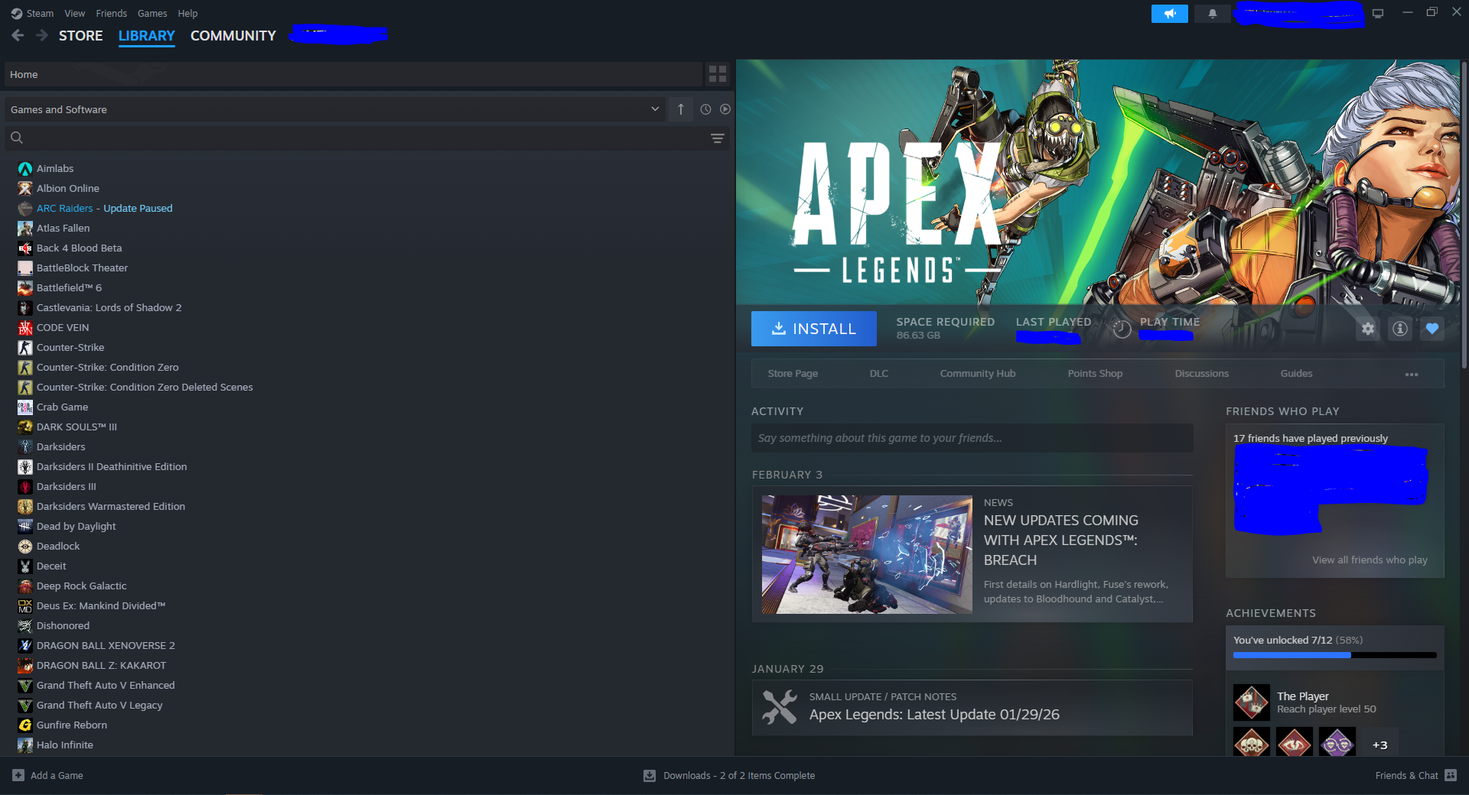
1. Name and describe three applications you have used that employed a database system to store and access persistent data. (e.g. airlines, online trade, banking, university system)
Steam – online platform that allows users to play games, interact through their digital market for in game purchases, and publish games (for game developers). Data about these interactions and users are stored as records on Valve’s DBMS (which seems to be a combination of PostgreSQL, in house proprietary DBMSs, etc), as well as partnering with third party CDN providers for storage capacity. Users can have various attributes that could classify them as developers, admins, employee, etc which have different levels of functionality. Some of the persistent data could include metadata about games that are available or have been available via the marketplace, user records, etc.

Slide 3
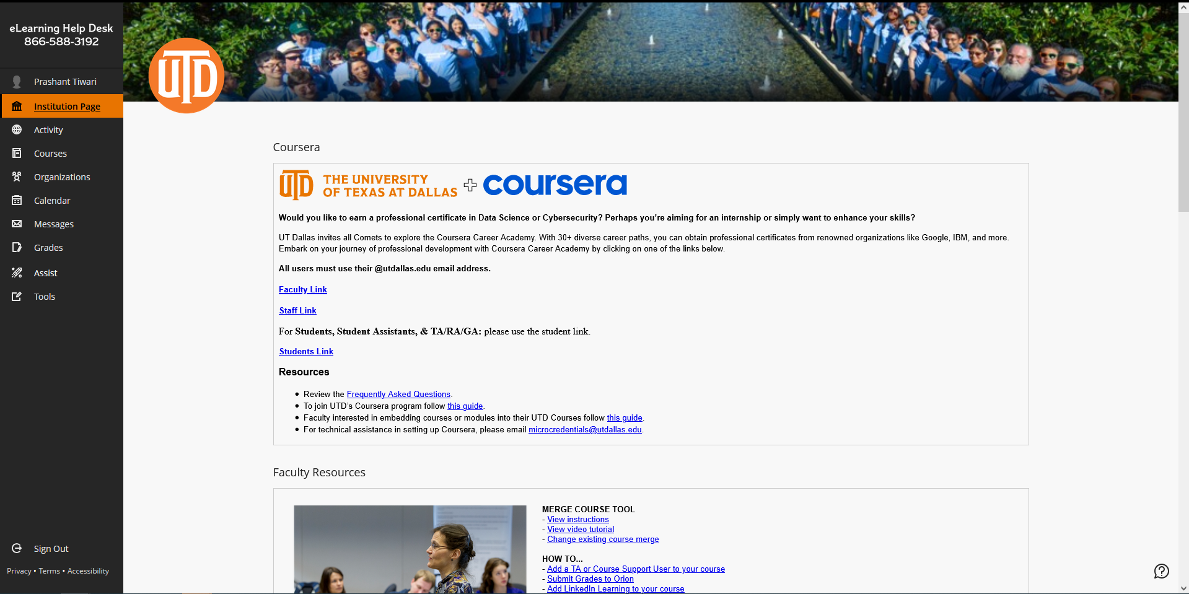
eLearning
Uses MSSQL, Postgres and Maria DB
MongoDB is also used for flexible content management
Stores records of Users, class information, professors, quizzes, enrollment records
Allows users to interact with varying levels of functionality depending on their classifications (Professors have different tools available on eLearning than students or admins, depending on their attributes)

Slide 4
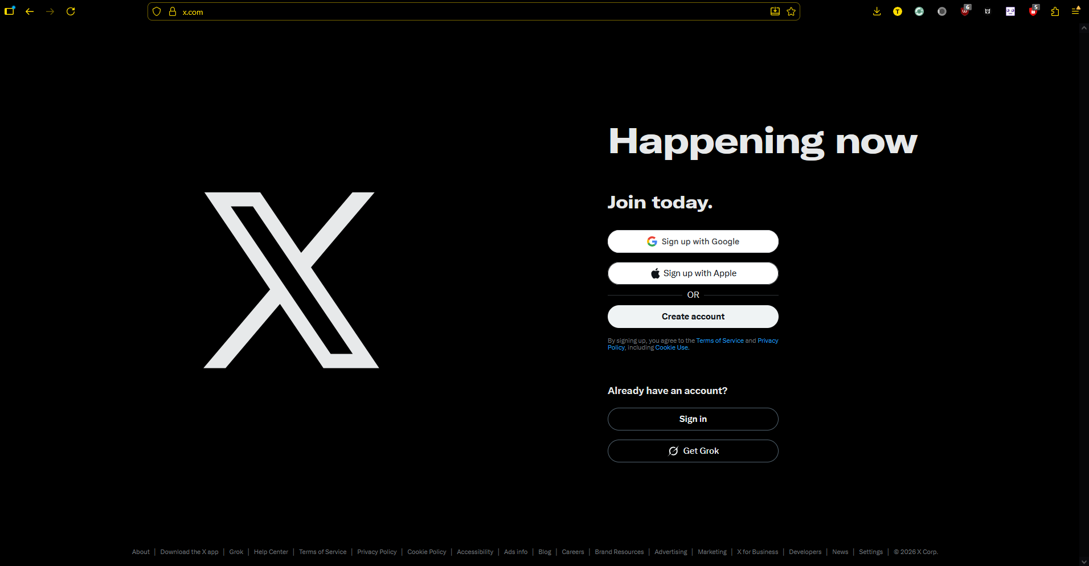
Twitter/X
User Records, Trends, events

Slide 5
2. Propose three applications in domain projects (e.g. criminology, economics, brain science, etc.)
1. Sports Science – Tracking tennis players average forehand speeds, court coverage at various points through matches across a season to identify trends (competitive applications), reaction times, etc. The function would be to improve training methods for athletes, make adjustments to different competitors, injury pattern indicators, granular breakdowns of player’s metrics vs rivals. The interface could be a search tool with a dashboard to breakdown by players, matches, tournaments, season and so on. Something like this already exists in the form of Tennis Viz but the data is somewhat limited by tournaments.

Slide 6
2. Agriculture economics for improvement/optimization of yield and crop performance. Works for farmers to make informed planting and selling decisions. Record crop yields, allowing to sort by farm, region, season etc. Allow for integration of real time weather data, commodity prices and have a compare functionality to compare on every level. For the interface, similar to previously suggested slide as a dash board with different tools, as well as a granular search function
3. Environmental science - AQ monitoring across time. Reference with data such as weather, traffic, industrial activity, etc.

Slide 7
Describe at least three tables that might be used to store information in a social-network/social media system such as Twitter or Reddit
User related information – account creation data, associated verification information such as phones or emails, friends and subreddits etc
Subreddit information – user counts, posts, upvotes/likes
Metadata of how different users or subreddits relate to each other (Popular/trending, Sports and so on)

Slide 8
If data can be retrieved efficiently and effectively, why data mining is needed?
Retrieving data and mining data are not the same thing
Mining data is using data to understand patterns or discover patterns that were unknown before
Data mining can be thought of as a sub category of data analysis, which also encompasses data retrieval
Example :A query tells you a player's serve speed dropped 8% in the third set. Data mining might reveal that across 200 matches, this player's injury risk increases 3x when their court coverage drops below a certain threshold in consecutive tournaments

